Slide 1
HL7 Da Vinci Training
February 11, 2025
Introduction to Health Record Exchange (HRex)
2025 HL7 Da Vinci Burden Reduction and Payor API Implementer Support

Slide 2

Who am I?
Name: Lloyd McKenzie
Company: Dogwood Health
Background:
One of FHIR’s 3 initial editors
Co-chair FHIR-Infrastructure, past chair FHIR Management Group, FMG member
HL7 Fellow
Technical lead for HRex IG
Da Vinci Deputy Technical Director
lloyd@dogwoodhealthconsulting.com

Slide 3

This presentation
Is part of a set of introductory training materials for the April 2025 Da Vinci Education Event
Can be downloaded here:
https://github.com/FHIR/documents/tree/master/presentations/2025-04-DaVinci
Is licensed for use under the Creative Commons, specifically:
Creative Commons Attribution 3.0 Unported License
(Do with it as you wish, so long as you give credit

Slide 4

Pre-requisites & Post-requisites
Before taking this course, you should first view:
Introduction to FHIR
How to Read a FHIR IG
USCDI/US Core
FHIR Security
Take this course before:
Any of the other Da Vinci IG detailed courses

Slide 5

Course Objectives
After completing this course, you should be able to:
Explain how HRex fits into the hierarchy of Da Vinci IGs
List the key functionality HRex covers
Navigate shared Da Vinci security expectations
Explain how Da Vinci member match functions
Summarize the HRex endpoint-discovery mechanism
Describe the Task-based data request flow

Slide 6
Outline
HRex Overview Outline
HRex Basics
Common Guidance
US Core Support
Member Match
Endpoint Discovery
Task-based Queries

Slide 7
HRex Basics

Slide 8

What is HRex?
Health Record Exchange (HRex):
Is a foundational guide for all Da Vinci IGs
Defines
Profiles
Data types
Operations
Guidance
that are common to all Da Vinci IGs

Slide 9


Why HRex?
Da Vinci has 15 implementable guides (so far)
HRex
Reduces authoring effort
Reduces implementer reading
Reduces discrepancies
Encourages re-use & consistency
Clinical Data Exchange
Coverage, Transparency & Burden Reduction
Clinical Data
Exchange (CDex)t
Payer Data Exchange (PDex)*
Coverage Requirements Discovery (CRD)*
Documentation Templates and Rules (DTR)*
Prior-Authorization Support (PAS)*
Foundational Assets
Formulary*
Plan Net/Directory*
Patient Cost Transparency (PCT)*
Member Attribution List t
Notifications *
Health Record Exchange (HRex)
Common CQL Assets for FHIR
Postable Remittance
Quality & Risk
Value-Based Performance Reporting (VBPR)
Data Exchange for Quality Measures/Gaps In Care
Risk Adjustment (RA)

Slide 10
Where does HRex fit?
Da Vinci ‘implementable’ IG
Implementers:
Don’t claim conformance to HRex
Will need to care about most content in HRex
HRex
US Core (3.1.1, 6.1.1, 7.0.0)
FHIR Core (R4)
Notes:
No CapabilityStatements in HRex

Slide 11
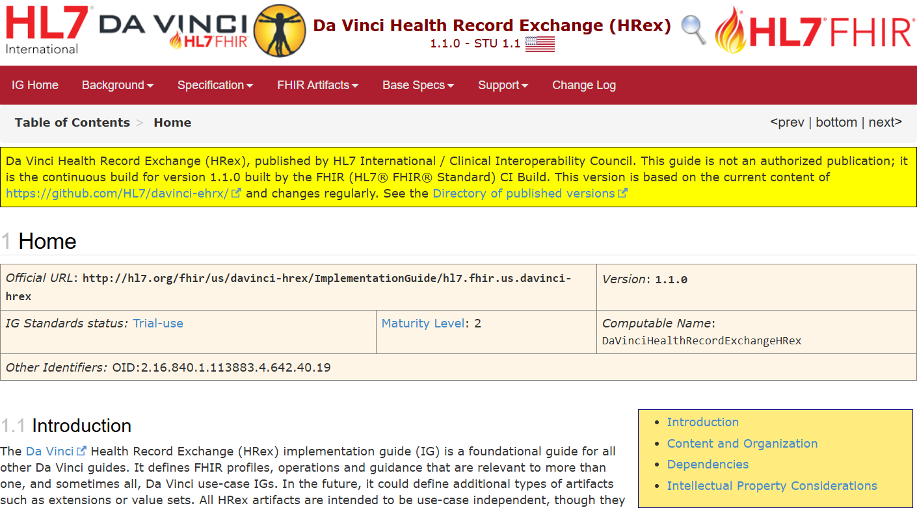
Navigating HRex
https://hl7.org/fhir/us/davinci-hrex

Slide 12
Common Guidance

Slide 13

Da Vinci Guiding Principles
IGs based on specific purpose of use
Responders can constrain and/or require approval for data access
IGs don’t supersede laws or regulations
Data exchanged should be limited to what’s needed for the purpose
Responders should provide reasonable access within those constraints
Payer access can’t be conditioned on Da Vinci membership or a requirement to share more than the IG defines
Code data where possible
Bulk exchange should be based on defined lists or member attribution
Minimize collection to what’s needed to support exchange requirements

Slide 14
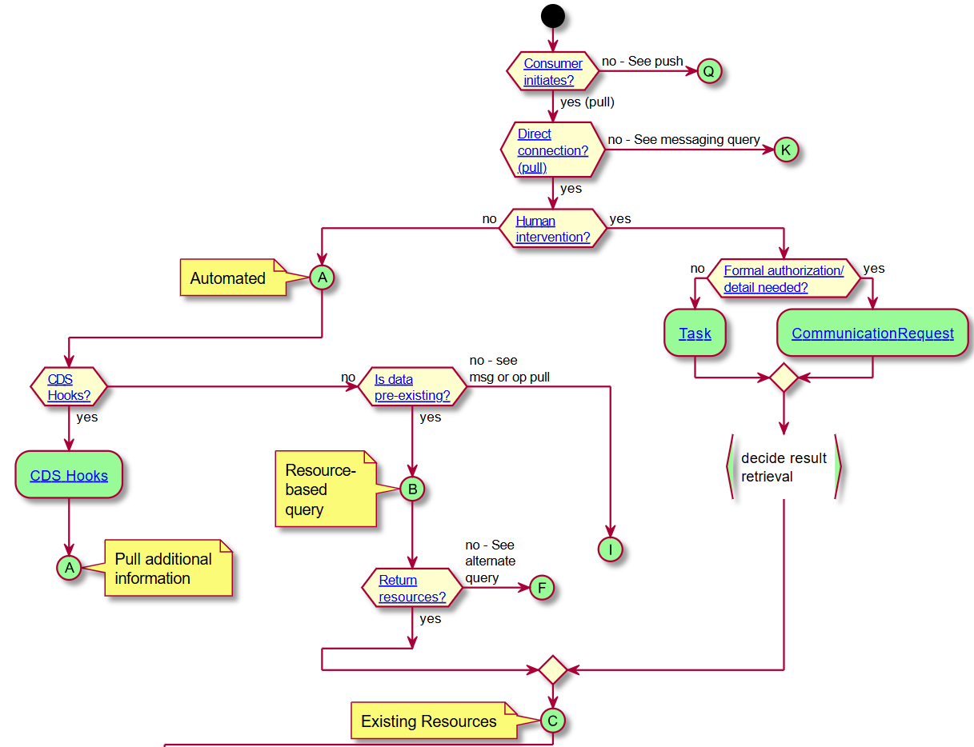

Approaches to Exchanging FHIR Data
Originally defined in HRex
Now maintained in core spec here:
Da Vinci guides are expected to
document decision tree pathway
CRD Example

Slide 15

Managing Instance Validation
Implementers SHOULD
Design interfaces to be tolerant of new FHIR versions
Not presume (or require) that meta.profile be declared
Be tolerant of data existing that goes beyond what’s required in profiles they support
Implementers MAY
Test instances against whatever profiles they care about; or
Just test for the presence of data they care about

Slide 16
mustSupport expectations
US Core requirements apply to elements defined as MS by US Core
For net new Da Vinci MS elements
Must be able to have data for the element
Can’t use Data Absent Reason to ignore mandatory elements unless DAR is part of the profile
Must be able to handle absence of values if a profile includes child extensions
mustSupports for US Core 6.1.0 and 7.0.0 only apply if the sender claims support for those US Core releases

Slide 17

Security, Privacy, and Consent
Adhere to federal and state statutes regulations and communication partner policies
Follow the FHIR core security rules and checklist
Support for fine-grained labeling and consent is fully optional
Shall use TLS for PHI, adhering to NIST guidelines
Identity verification should be done by one of:
SMART App Launch
SMART Back-end Services
FAST UDAP
Mutual TLS
Notes:
Specific expectations for Mutual TLS

Slide 18
Data Protection Expectations
Open data
E.g. Payer’s provider directory
Sensitive business information
Protection up to supplier
Token/key exchange
Identity confirmation & secure exchange required
No identity, access, authentication or audit requirements
May still protect site (e.g. DoS)
E.g. open schedule slots, aggregated patient data
Follow best practices
PHI
Verify requester identity and permissions
Log all exchanges
If with a BA, must have a BAA
Notes:
BAA = business associate agreement

Slide 19
US Core support

Slide 20

US Core Requirements
Dec. 31, 2022: 21st Century Cures Act mandates USCDI v1
US Core 3.1.1
Jan. 1, 2026: HTI-1 mandates migration to USCDI v3
US Core 6.1.0
Jan. 1, 2028: HTI-2 proposed rule to require USCDI v4
US Core 7.0.0

Slide 21
Da Vinci US Core Strategy
Analysis
Newer US Core versions are largely backward compatible
Add new profiles and optional data elements
It’s possible to create instances that comply with all 3 editions
Decision
All Da Vinci guides will move to handling all 3 versions of US Core
EHRs will expose whatever version they currently support
Payers will handle all of them

Slide 22
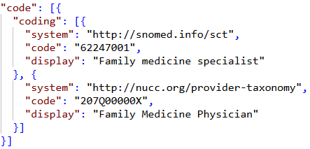
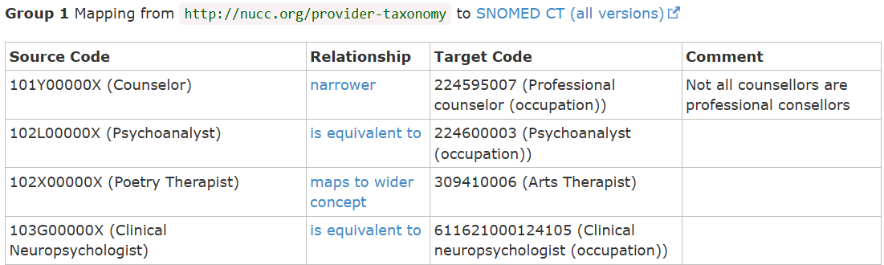
HRex US Core Support
HRex:
Defines and explains Da Vinci US Core strategy
Sets base conformance expectations
Profiles PractitionerRole to meet multiple versions
Includes concept-map for code translations

Slide 23
Member Match

Slide 24

Why Member Match?
In legacy (e.g. message-based) exchanges
Share all coverage information and demographics
In FHIR
Share a resource id or business identifier
Problem:
What’s the resource id/business identifier a given payer uses for ‘my’ member?
Needed for payer-to-payer and other exchanges

Slide 25
Member Match Design
Custom operation: [base]/Patient/$member-match
Like ‘Patient match’, but includes Coverage information
Can be invoked by payers or providers
Shares requesting payer information to allow bi-directional linking
Allows transmitting limited consent information
Authorization to share all or only non-sensitive
Period consent applies for

Slide 26
Member Match Design (cont’d)
Must return a business identifier, may return a Patient ‘id’
Business identifier must span all coverages
Must return a single match – otherwise 422 error
Matching algorithm is payer-specific

Slide 27
Operation Inputs
Parameter | Cardinality | Type | Description
MemberPatient | 1..1 | US-Core Patient | Demographics of member to match
CoverageToMatch | 1..1 | HRex Coverage | Card information of member to match in receiver’s system
CoverageToLink | 0..1 | HRex Coverage | Card information from sender’s system
Consent | 0..1 | HRex Consent | Basic consent data

Slide 28
Endpoint Discovery

Slide 29
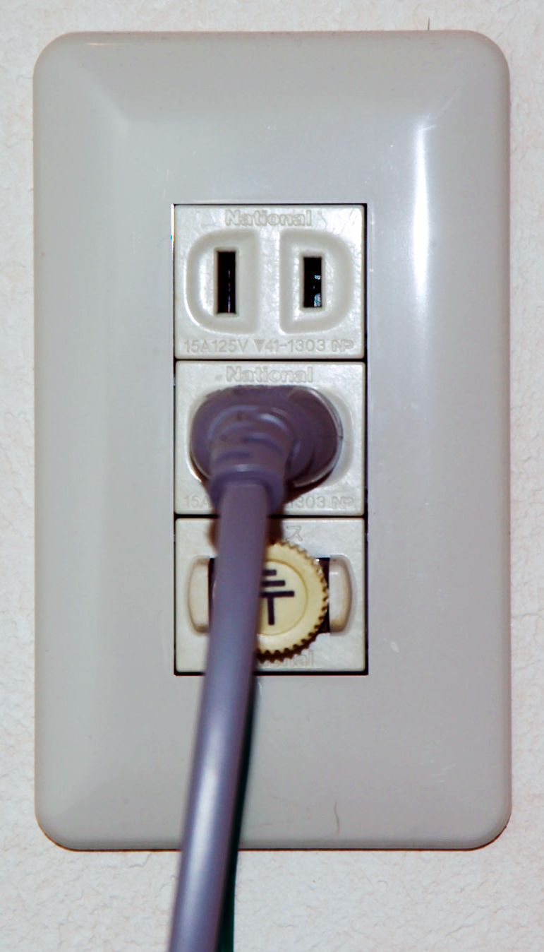
Why Endpoint Discovery
Most Da Vinci IGs require payers to expose endpoints. E.g.
CRD hook endpoint
CDex attachment submit endpoint
PDex patient data endpoint
Endpoints may
vary by coverage
change over time
It’s difficult to keep all providers up-to-date

Slide 30
Endpoint Discovery Solution
Piggy-back on X12 270 Eligibility Benefit Inquiry Check
Providers perform this before any other patient-related action
Provide a single URL in the PER segment in the 2000A Information Source name loop
This URL is the .well-known/davinci-configuration file
File can also be pointed to by an extension on ‘Coverage’
Can be returned by member-match, etc.

Slide 31
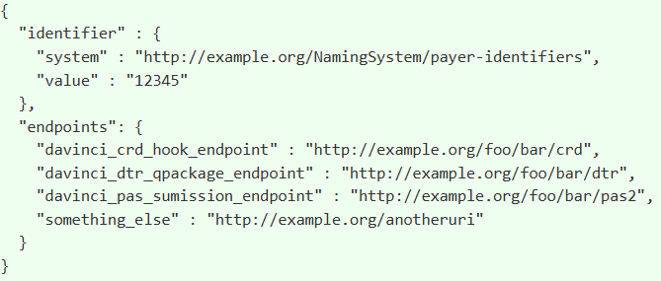
.well-known file structure
Simple JSON file that conveys:
Payer identifier
List of endpoints by type
HRex maintains a list of endpoint types

Slide 32
Endpoint Discovery Considerations
.well-known file returned is specific to the patient’s Coverage(s)
Could be a static file or generated on-the-fly
If endpoints change, just update the .well-known file

Slide 33
Task-based Query

Slide 34

Task-based Query purpose
Preferred data retrieval mechanism in FHIR is RESTful search
However:
Not all data will be accessible
Accessible data may not be well-coded
Data may be buried in PDFs / other documents
Source systems may not be comfortable providing broad search access
Reality – sometimes a human may need to be in the loop

Slide 35
Task-based Query Design
POST a Task instance to payer’s system
Task indicates:
Type of data to retrieve
LOINC code
FHIR search to run
Textual description
Reason for request (string, Claim or Coverage)
Patient, requester, recipient, date

Slide 36
Task workflow
Once created, Task status is updated
accepted, refused, in-progress, completed, failed, etc.
Can also provide ‘business status’ text with more details
Requester monitors using
Polling (simple but expensive)
Subscription (more complex, but less resource intensive)

Slide 37
Summing Up

Slide 38
Course Objectives
After completing this course, you should be able to:
Explain how HRex fits into the hierarchy of Da Vinci IGs
List the key functionality HRex covers
Navigate shared Da Vinci security expectations
Explain how Da Vinci member match functions
Summarize the HRex endpoint-discovery mechanism
Describe the Task-based data request flow

Slide 39



Questions/Discussion
lloyd@dogwoodhealthconsulting.com
Or, better yet, include the community and ask/discuss on https://chat.fhir.org/#narrow/channel/433432-Da-Vinci-HRex

